Slide 1















Corona Virus Analysis using SQL
Presented by S Rohan
Batch Name: MIP-DA-09

Slide 2

Overview
The CORONA VIRUS pandemic has had a significant impact on public health and has created an urgent
need for data-driven insights to understand the spread of the virus. As a data analyst, you have been tasked with analyzing a CORONA VIRUS dataset to derive meaningful insights and present your findings..

Slide 3

Dataset
Province: Geographic subdivision within a country/region.
Country/Region: Geographic entity where data is recorded.
Latitude: North-south position on Earth's surface.
Longitude: East-west position on Earth's surface.
Date: Recorded date of CORONA VIRUS data.
Confirmed: Number of diagnosed CORONA VIRUS cases.
Deaths: Number of CORONA VIRUS related deaths.
Recovered: Number of recovered CORONA VIRUS cases.pl

Slide 4
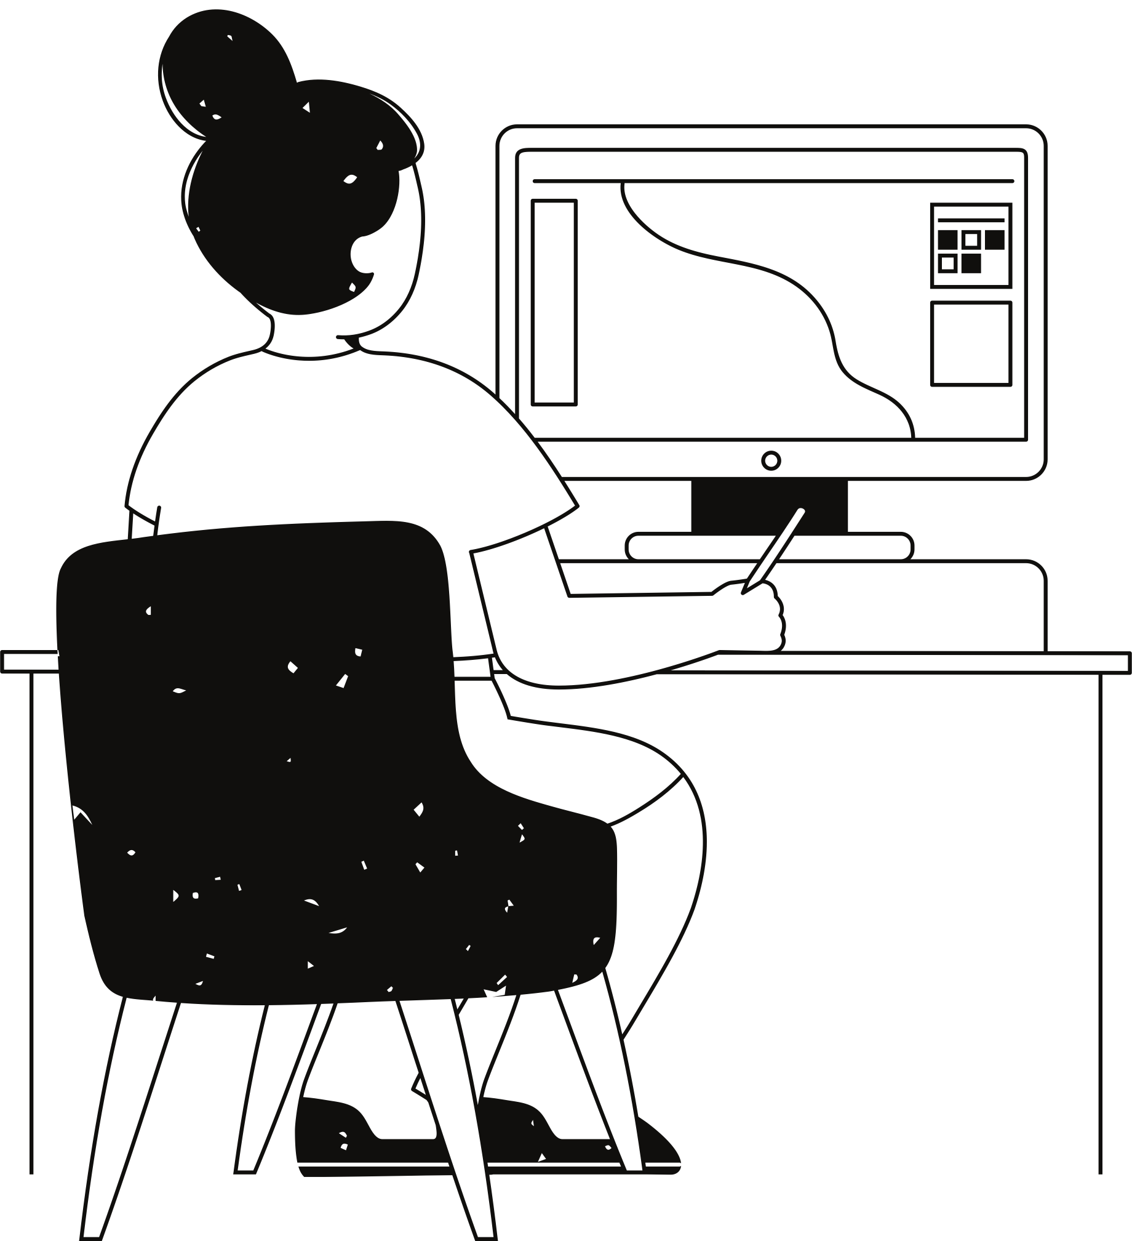
Queries

Slide 5
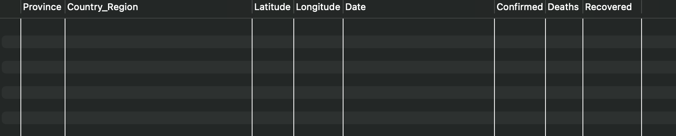
Q1. Write a code to check NULL values
Query :
Output :

Slide 6
Q2. If NULL values are present, update them with zeros for all columns.
Since it table has no NULL value, we can skip this

Slide 7
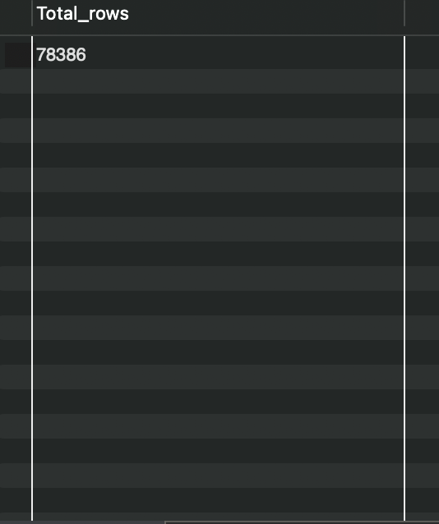
Q3. check total number of rows
Query :
Output :

Slide 8
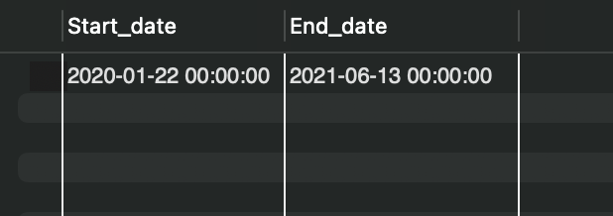
Q4. Check what is start_date and end_date
Query :
Output :

Slide 9
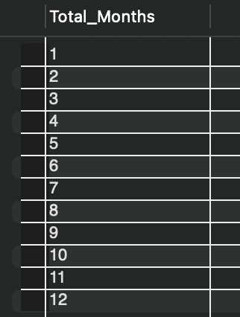
Q5. Number of month present in dataset
Output :
Query :

Slide 10
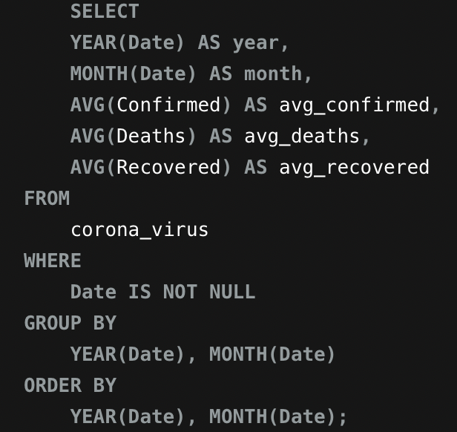
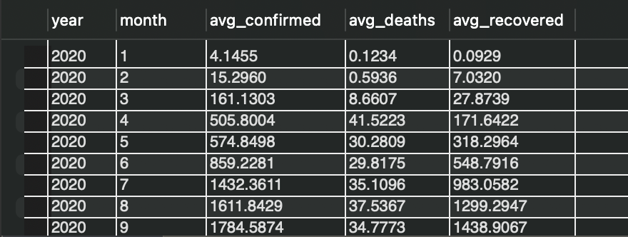
Q6. Find monthly average for confirmed, deaths, recovered
Query :
Output :

Slide 11
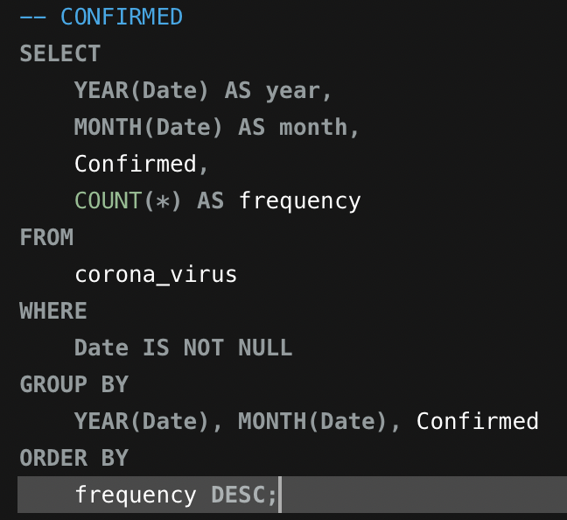
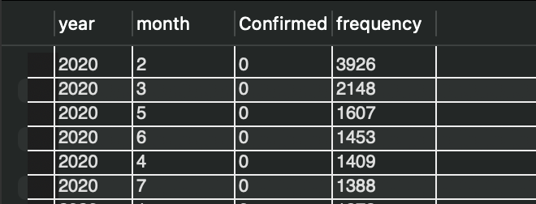
Q7. Find most frequent value for confirmed, deaths, recovered each month
Query :
Output :

Slide 12
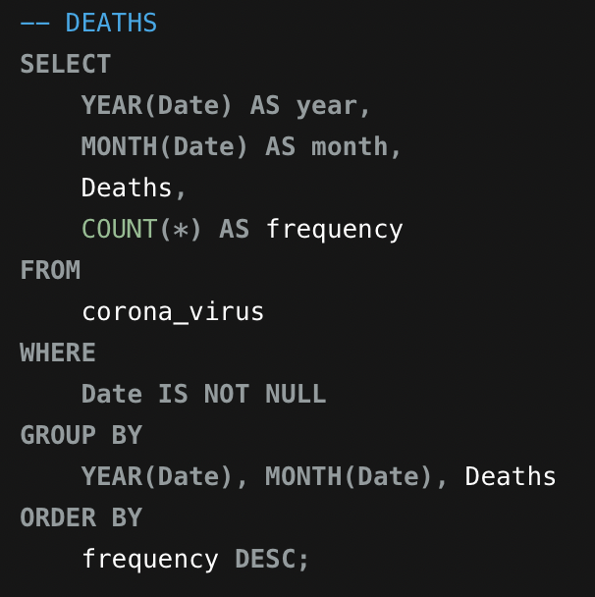
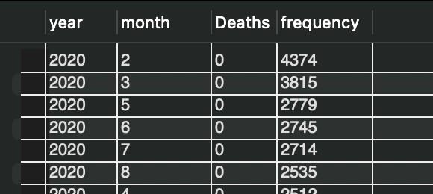
Q7. Find most frequent value for confirmed, deaths, recovered each month
Query :
Output :

Slide 13
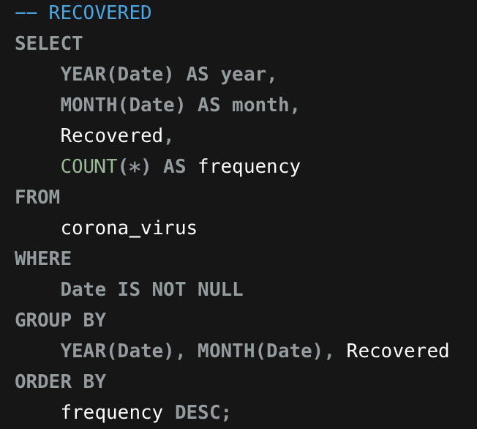
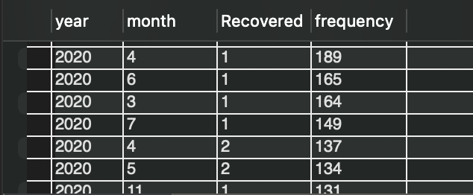
Q7. Find most frequent value for confirmed, deaths, recovered each month
Query :
Output :

Slide 14
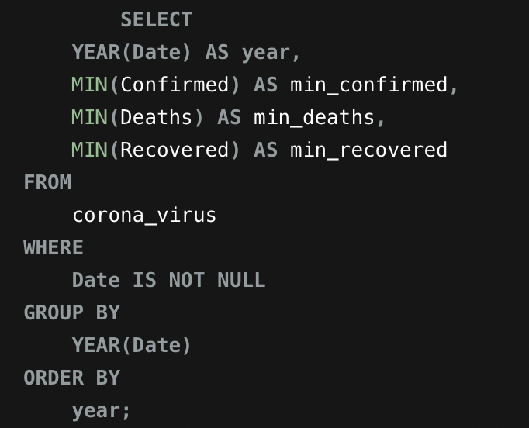
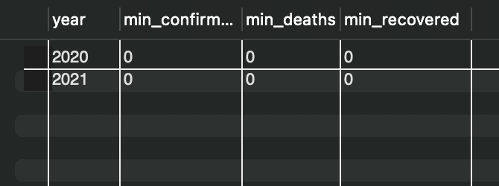
Q8. Find minimum values for confirmed, deaths, recovered per year
Query :
Output :

Slide 15
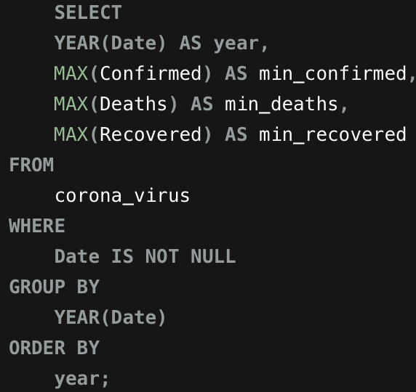
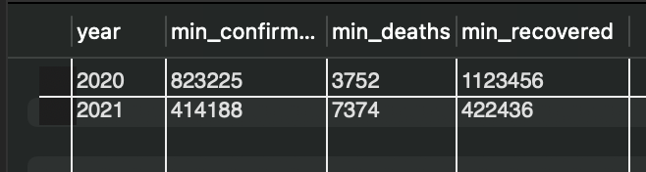
Q9. Find maximum values of confirmed, deaths, recovered per year
Query :
Output :

Slide 16
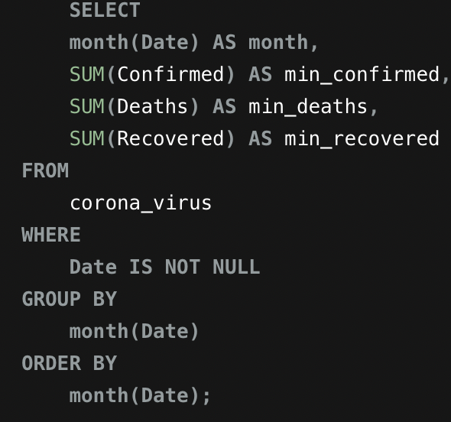
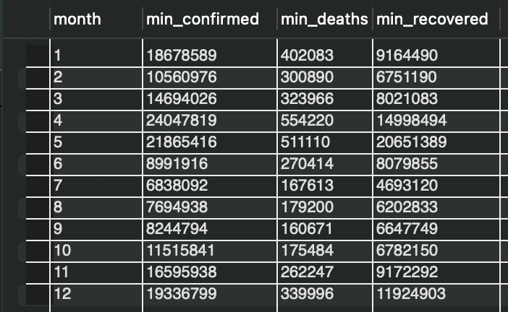
Q10. The total number of case of confirmed, deaths, recovered each month
Query :
Output :

Slide 17
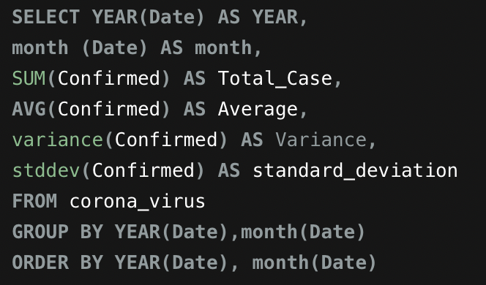
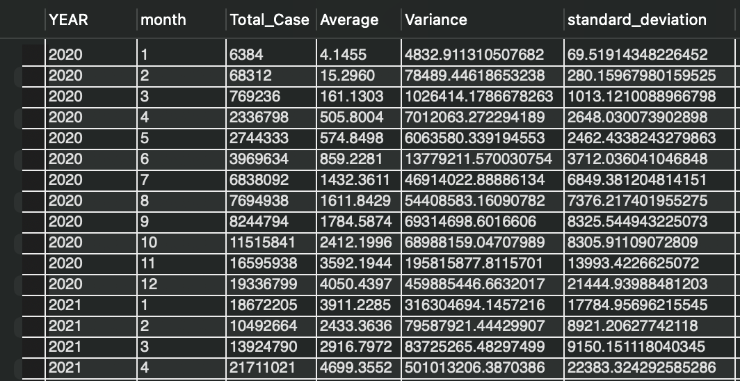
Q11. Check how corona virus spread out with respect to confirmed case (Eg.: total confirmed cases, their average, variance & STDEV )
Query :
Output :

Slide 18
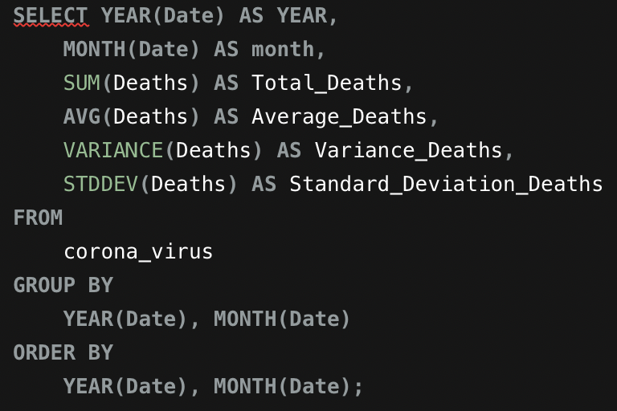
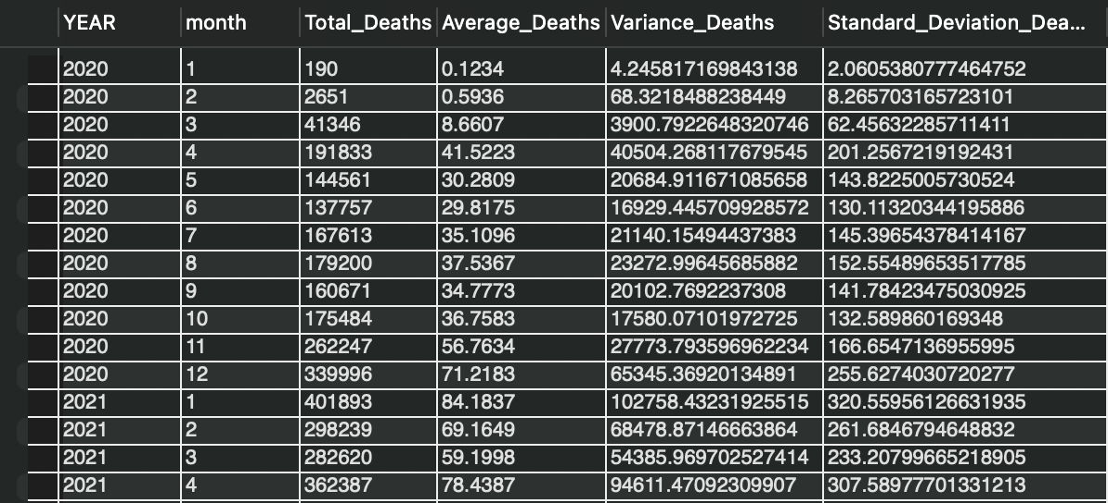
Q12. Check how corona virus spread out with respect to death case per month (Eg.: total confirmed cases, their average, variance & STDEV )
Query :
Output :

Slide 19
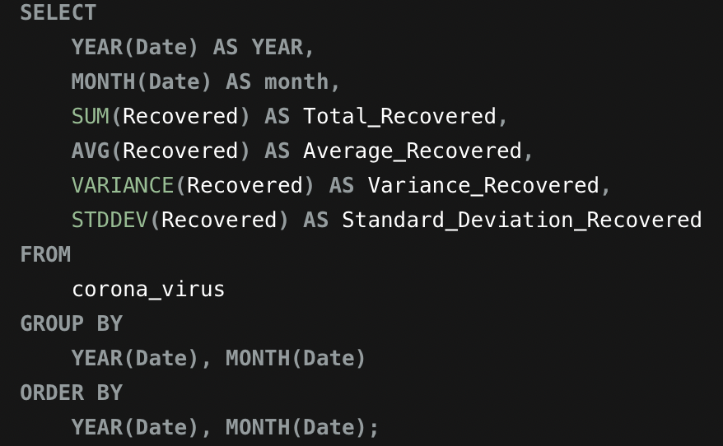
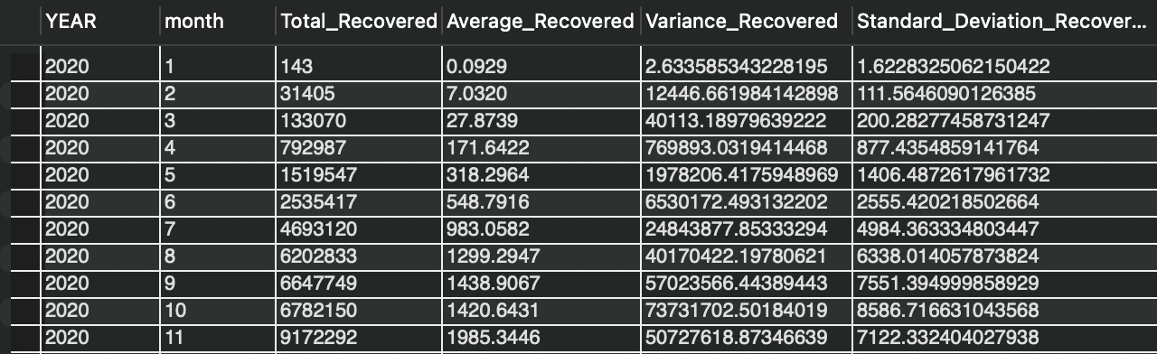
Q13. Check how corona virus spread out with respect to recovered case (Eg.: total confirmed cases, their average, variance & STDEV )
Query :
Output :

Slide 20
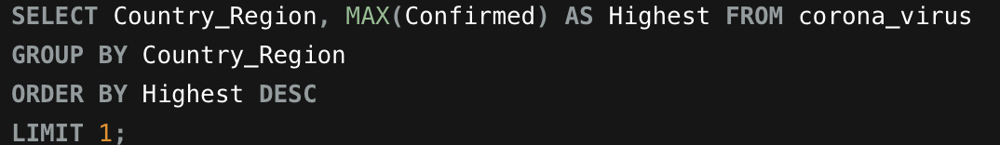
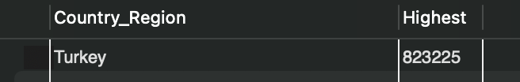
Q14. Find Country having highest number of the Confirmed case
Query :
Output :

Slide 21
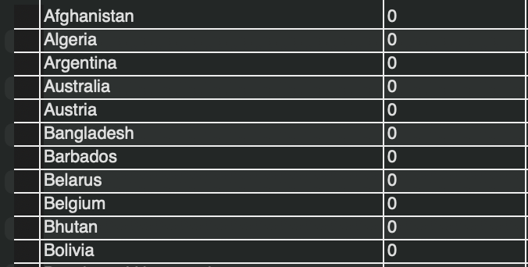
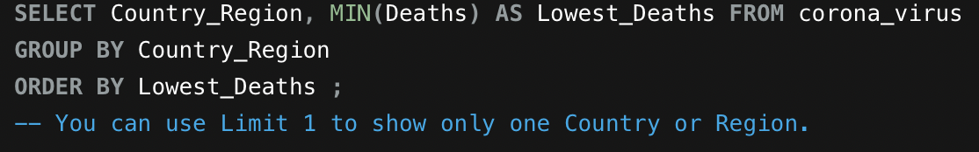
Q15. Find Country having lowest number of the death case
Query :
Output :

Slide 22
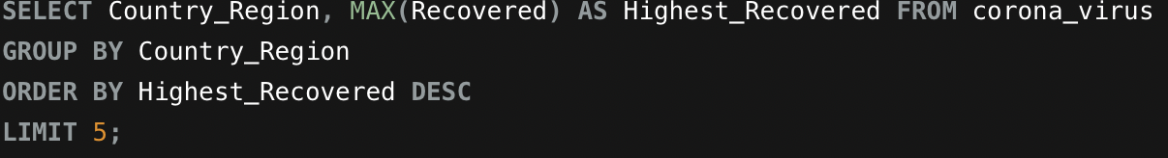
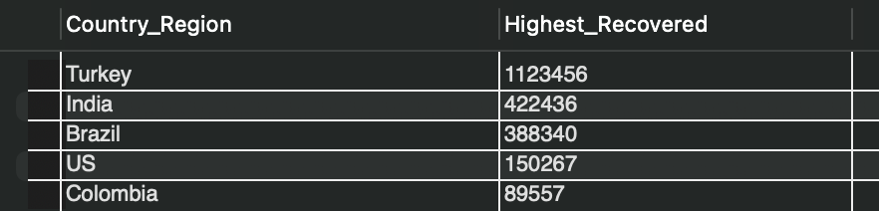
Q16. Find top 5 countries having highest recovered case
Query :
Output :

Slide 23
Thank you

